Slide 1
Computer Graphics
Day II

Slide 2
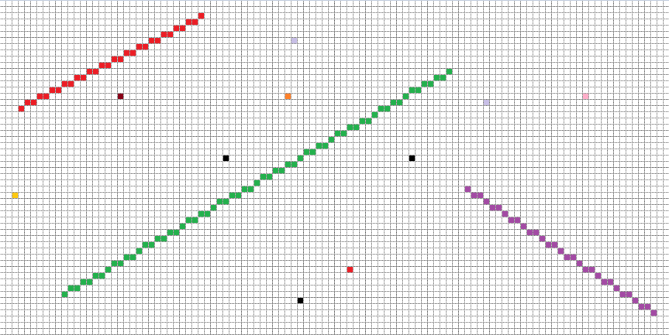
Vector Graphics on a Raster Grid
X2, Y2
Origin: X0,Y0
Dimensions: Width X, Height Y
X1, Y1

Slide 3
Drawing Points
Not much to say here, its as simple as you think it is.
Choose a location X, Y and a color.
Determine where in the Raster Grid the point falls & edit the value.
You may need to perform a simple 2D to 1D conversion. (Y * WIDTH + X)
Don’t forget to adds bounds checking in debug mode to catch errors.
Adding a third dimension, sorting based on depth, and blending overlapping points together can make this much more interesting.
For now though, we will just stick to the basics.

Slide 4
Drawing Lines requires Line Equations
This is not quite as simple…
Unlike a Vector Display the Raster Display cannot represent lines directly.
Instead we must plot a set of pixels that try to follow the “true” line.
Lines have a starting point & an ending point. (coding tip: use a structure)
The final line should not be “thicker” than one pixel perpendicular to said line.
There are several effective ways to approach this problem.
But first we need to have a strong understanding of lines themselves.

Slide 5
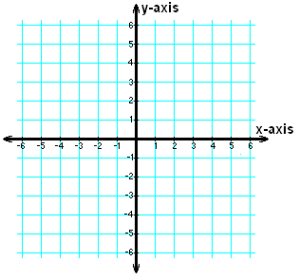
Lines Can Have Slope
X2, Y2
B = y axis intercept
The slope of a line is often described as it’s Rise (change in Y) over its Run (change in X).
Slope = Rise / Run
M = (Y2 – Y1) / (X2 – X1)
Slope Intercept Line Equation: Y = MX + B
X1, Y1
Not Bad… Could this work for any 2D line?

Slide 6
Dealing with Vertical Lines
X2, Y2
Unfortunately slope intercept does not work on vertical lines because they have no slope.
A different line equation is required to handle any line regardless if it has slope or not:
General Line Equation: Ax + By + C = 0
Where A, B & C are constant values.
A or B can be 0 but never at the same time.
There are infinite combinations of A,B,C that describe the line. We just need a valid one!
B = ???
X1, Y1
We need to handle cases without slope!

Slide 7
Implicit Line Equation Using the Gradient Vector
Vector parallel to the line.
XY = (X2 - X1, Y2 – Y1)
The gradient vector is the vector which is perpendicular to this vector. (dot product of 0)
AB = (Y1 – Y2, X2 – X1)
You can use the gradient vector to solve for C in the general line equation.(All points on the line lie somewhere along the gradient vector)
Ax + By + C = 0
C = -Ax - By
C = -(Y1 – Y2)X1 - (X2 – X1)Y1
C = X1Y2 – Y1X2
Which yields the Implicit Line Equation:
(Y1 – Y2)x + (X2 – X1)y + X1Y2 – Y1X2 = 0
XY
X2, Y2
AB
X1, Y1
Implicit Line Equation has no division

Slide 8
The Result of the Implicit Line Equation
3
∝ XY
2
1
0
-1
X2, Y2
A result of 0 is what is to be expected if a point lies directly on the line.
However a point that does not lie exactly on the line is still somewhere along the gradient vector.
The result of the equation is actually a signed distance from the original line proportional to the length of the gradient vector.
You can then convert this to an actual distance:
D = Implicit Result / Gradient Length
This is incredibly valuable information that will come in handy more than once.
-2
3
∝ AB
-3
2
1
D
X1, Y1
0
X3, Y3
-1
-2
-3
This could come in handy…

Slide 9
The Parametric Line Equation
P1
ΔX
ΔY
ΔPY
Written in Vector Form:
P(R) = P1 + R(P2 – P1)
Looks a lot like linear interpolation doesn’t it?
That’s because that’s exactly what it is!
The only time you need to be cautious is when deriving R.
Can you see a possible issue when choosing a pair of Deltas?
R = ΔX / ΔPX
= ΔY / ΔPY
ΔPX
P2
Simple and VERY Effective!

Slide 10
Line Drawing Algorithms
Positive X Axis
(0,0)
(1,0)
(2,0)
(0,1)
(1,1)
(2,1)
Positive Y Axis
(0,2)
(1,2)
(2,2)

Slide 11
Bresenham Line
The “Classic” line drawing equation. (Bresenham,1962)
Attempts to draw a straight line while accumulating “error”.
This error is the accumulating slope of the “true” line.
Once the error exceeds 22.5º degrees we “correct” our line by moving to be closer to the true line.
We then reduce our error value by 45º degrees. (The amount adjusted)

Slide 12

Bresenham Line Algorithm
0.0
0.5
CurrY = StartY
Slope = ΔY / ΔX
Error = 0
FOR StartX to EndX
PlotPixel ( CurrX, CurrY )
Error += Slope
IF Error > 0.5
CurrY += 1, Error -= 1
X1, Y1
0.0
0.5
0.0
0.5
X2, Y2

Slide 13
Midpoint Line
This algorithm is based on the “Midpoint” of the next pixel to be drawn.
The midpoint is the upper middle point of the “next” pixel relative to the line’s primary direction. (ex: +X, -X, +Y, -Y)
If the midpoint is below the “true” line we shift the next pixel to be closer to the line.
We can use the “implicit line equation” discussed earlier to make this determination.

Slide 14
Midpoint Line Algorithm
X1, Y1
CurrY = StartY
FOR StartX to EndX
PlotPixel ( CurrX, CurrY )
Midpoint = CurrX + 1, CurrY + 0.5
IF ImplicitLineEquation ( Midpoint ) < 0
CurrY += 1
X2, Y2

Slide 15
Parametric Line
Calculates a ratio based on how much line we have already drawn.
This ratio is then fed into the “parametric line equation” to get XY.
Computes the “true” location of a pixel on the “true” line.
This result must be rounded to the nearest pixel.
Essentially this is linear interpolation for line drawing.

Slide 16
Parametric Line Algorithm
X2, Y2
FOR StartX to EndX
Ratio = ( CurrX – StartX ) / ΔX
CurrY = Lerp ( StartY, EndY, Ratio )
PlotPixel ( CurrX, Floor ( CurrY + 0.5 ) )
X1, Y1

Slide 17
For Lab: Dealing with Varying Slope
The pseudo code for the various line algorithms all describe how to draw a line with positive slope in the first octant only.
You will need to adapt these formulas to handle a variety of lines which may not even have slope, let alone positive slope.
Here are some Tips:
Determine what direction the line is traveling in.(+X,-X,+Y,-Y)
Is the line “Steep”? Does it have a greater change in Y than X?
Dividing by 0 is a problem, dividing by “almost 0” isn’t.
While some line drawing algorithms could be done only with integer arithmetic, others require floating point calculations.
The midpoint algorithm is challenging to generalize completely. Look for a recurring pattern based on X dir Y dir and line “Steepness”.
6th
7th
5th
8th
+X
4th
1st
3rd
2nd
+Y
OCTANTS

Slide 18
Applicable Reading Assignment
For next time read:
In Chapter 2 Miscellaneous Math:
Read section 2.7
In Chapter 5 Linear Algebra:
Read section 5.2
In Chapter 6 Transformation Matrices
Read sections 6.1 – 6.2
In Chapter 3 Raster Algorithms (From 2nd Edition):
Read section 3.6

